Slide 1
MQTT
Raspberry PI
ESP8266 Nodemcu

Slide 2
MQTT - Intro
MQTT – explain
Raspberry pi – broker
Nodemcu – client
Nodered - client

Slide 3
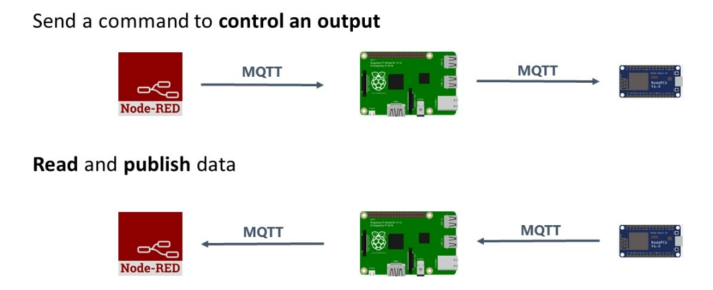
MQTT - explain
Message queing telemetry transport – communication protocol
Publish client → broker → subscribe client
Notes:
Leightweight communication protocol, der bygger på clienter der publisher data til en broker og clienter der subscriber på data fra brokeren

Slide 4
Prerequisites
Setting up a broker on raspberry pi for channeling messages
Setting up nodered on raspberry pi as a client in order to interface with the nodemcu
Making the hardware connections
Programming the nodemcu and the notered dashboard

Slide 5
Raspberry pi – mosquitto broker
See guide for software installation
Quick tour of linux command line

Slide 6
Raspberry pi - nodered
See guide for software installation
Creating a dashboard
Core nodes

Slide 7
Making hardware connections
Depending on what we want to do.. ‘Everything’ is possible
Lets start simple and build together (Example: ½ of class makes subscribtion to blink an LED, other ½ publishing an switch of some kind)

Slide 8
ESP8266 nodemcu
Arduino IDE – legacy version 1.8xxx, works best for ESP8266
Including libraries
Setting up wifi connection
Setting up mqqt connection
Writing some code

Slide 9

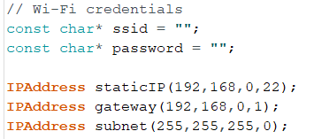
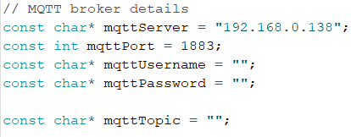

Libraries: wifi connection – mqtt connection
Include libraries in sketch:
Variables for libraries:
Instantiate libraries:
Notice how we use the
Wifi client as an attribute
for the mqtt client.

